Slide 1
Presentation on eCommerce shopping website
TEAM 4 PRESENTING BY:
ANUDEEP
PRAJWAL
RANJITHA
SACHIN

Slide 2
INTRODUCTION
eCommerce primary goal is to sell goods and service online.
Online shopping is a form of electronic shopping store where the buyer is directly online to the sellers computer usually via the internet.
A person sitting on his chair in front of a computer can access all the facilities of internet to buy a product.
Online shopping helps in buying of products by choosing the listed product from website

Slide 3
This website contains
HOMEPAGE: it serves as the starting point of website .It is the default webpage that loads when we visit a web. The home page is located in the root directory of website.
The home page provides navigation bar that provides links to different sections within the website.
Home page contains many parts of the system like
Cart: user can see the products that he added to the cart.
Shop: user can see the product and can view the product details.

Slide 4
Logout: user can logout from the website.
Shopping cart page: This page is accessed when a user clicks cart link on home page to show the information of all the products added to the shopping cart.
Shop page: It is the page of the application where all available products with a quantity greater than zero are displayed.

Slide 5
The categories page :is the page for managing product categories for the e-commerce store, and it is accessed by clicking the manage categories link on the admin menu page.
Add Category Page: This page for adding product categories . The page displays the add category form when an admin user clicks the link for adding a category on the categories page.
Products Page :It is the page for managing products of the online store and is accessed by clicking the manage products link on the admin menu page.

Slide 6
Technologies used
Front end:
HTML
CSS
BOOTSTRAP 4
GOOGLE FONT-API
BOXICONS-API
Back end:
JAVA
SPRING BOOT
JPA
H2 Database
THYMELEAF

Slide 7
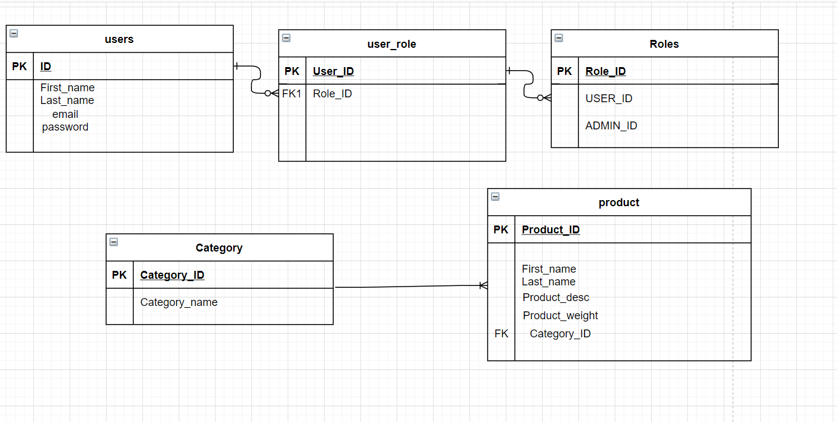
CLASS DIAGRAM

Slide 8
THANK YOU

